Slide 1

Deciphering Earnings:
A Binomial Classification Approach to Predicting Income Levels Above $50K
DS 6372 Applied Statistics
Steven Cox
Adam Ercanbrack
Joel Laskow

Slide 2
Statement of Purpose
The purpose of this study is to utilize modern classification techniques to predict income status
Income Status
<$50,000
>$50,000

Slide 3


I.Data Summary
II.EDA
III.Objective 1
A.Model 1
IV.Objective 2
A.Model 2
B.Model 3
V.Conclusion

Slide 4

Data Summary
Initial data obtained from 1994 U.S. Census Data. Dataset initially performed by Barry Becker and Ronny Kohavi
Total Data
32,562 Observations
15 Variables
2,434 Mislabeled / missing Values
DOI: 10.24432/C5XW20
Data available from UC Irvine Machine Learning Repository
https://archive.ics.uci.edu/dataset/2/adult

Slide 5
Data Summary
Predictors:
Age
Working Class
Level of Education
Years of Education
Marriage Status
Occupation
Household Role
Race
Capital Gain
Capital Loss
Hours Worked
Native Region
Gender
Investor

Slide 6
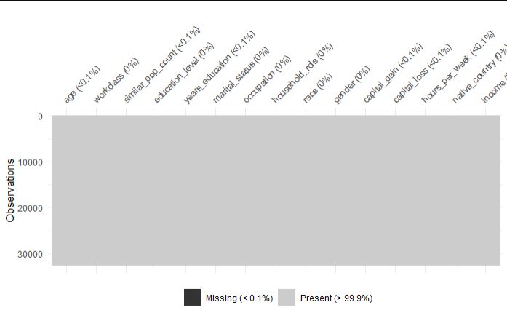
Data Cleaning
Cleaning
2,419 values marked as ‘?’
15 missing values
Spaces before value names
Columns renamed
Fnlwgt as similar_pop_count
Sex as gender
Education_num as years_education
Columns added
Invested
Age_span
hourse_worked_span
Notes:
Values marked as “?” 583 native_country, working_class 1836.

Slide 7
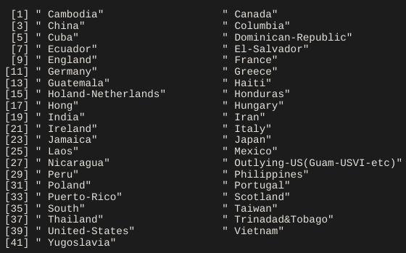
High Data Complexity
Native Country contains 41 levels
High level count makes interpretation laborious
Solution:
Condense country levels to REGION of origin:

Slide 8
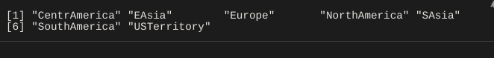
High Data Complexity
41 Levels
7 Levels
Far More Manageable!

Slide 9
Additional Consolidation
Highest Education Completed
Marital Status
Old Levels | New
“Preschool” | “no_edu”
“1st-4th” and “5th-6th” | “primary”
“7th-8th” | “secondary”
“9th”, “10th”, “11th”, “12th”. “HS-grad” | “highsch”
"Assoc-acdm", "Assoc-voc", "Some-college" | “undergrad”
"Bachelors", "Prof-school" | “master”
“Doctorate” | “phd”
Old Levels | New
"Divorced", "Separated" | “divorce”
“Married-AF-spouse", "Married-civ-spouse", "Married-spouse-absent” | “married”
“Never-married” | “notmarried”
“Widowed” | “widowed”

Slide 10

Exploratory Data Analysis (EDA)

Slide 11
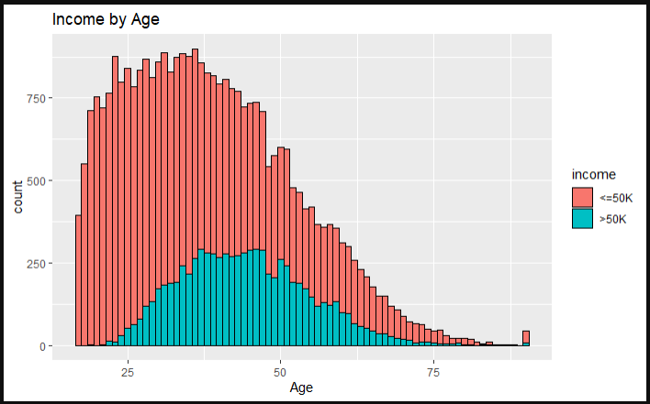
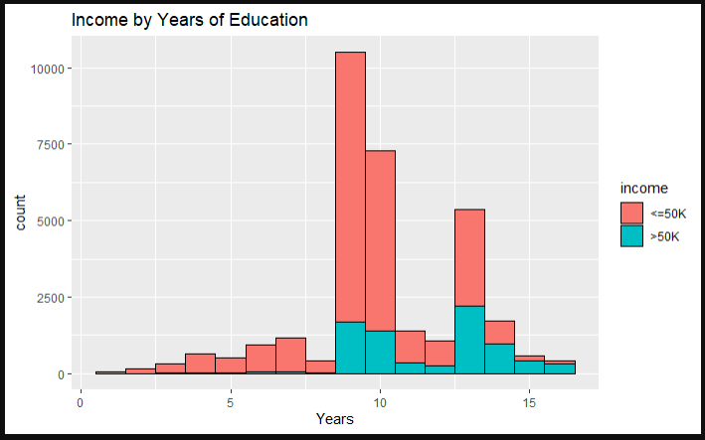
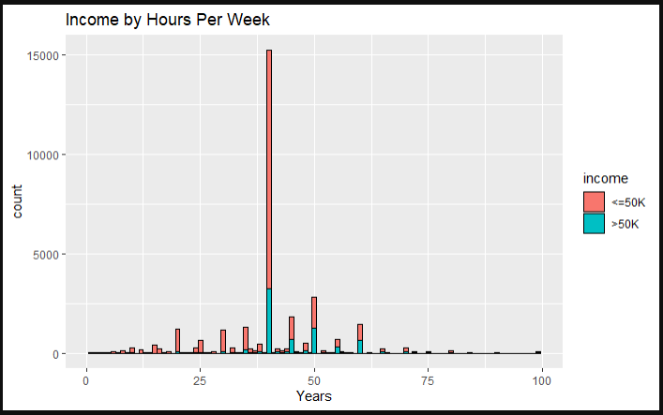
Visual Inspection
Continuous variables:
Age - Counts of age show some right skewedness, Less on >50K
Hours - Most hours fall in the 40 hour week area, somewhat skewed right
Education - More normally distributioned, favoring >50K after 9 years
Notes:
[Come back to this slide. LOESS curves do not show evidence of relationship between hours worked and odds of higher income status] Some evidence of overlapping distribution

Slide 12
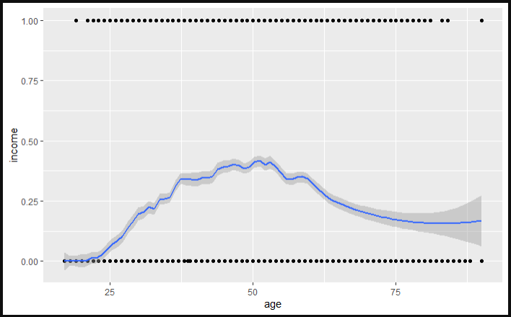
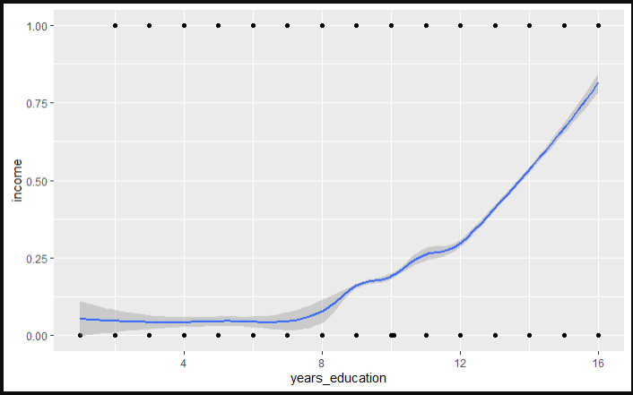
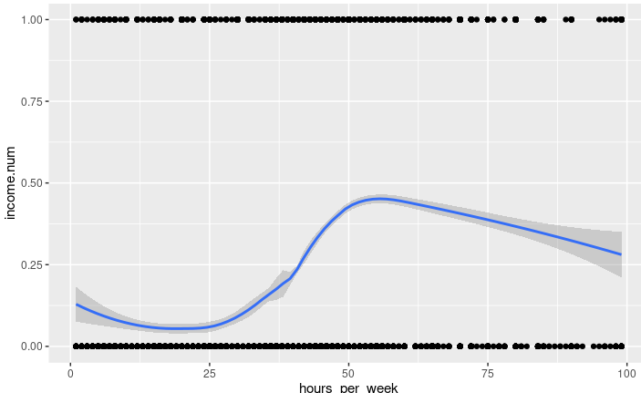
LOESS Plot Comparison
Age - Dropoff after 50 years
Hours - Evidence of complex relationship
Education - Higher education, higher proportion of high-income statuses
Notes:
Continuous Variables: years_education shows continuous growth, age and horse_per_week tend upward and then downward suggesting that there might be a more complex relationship and dampened significance against Income.

Slide 13
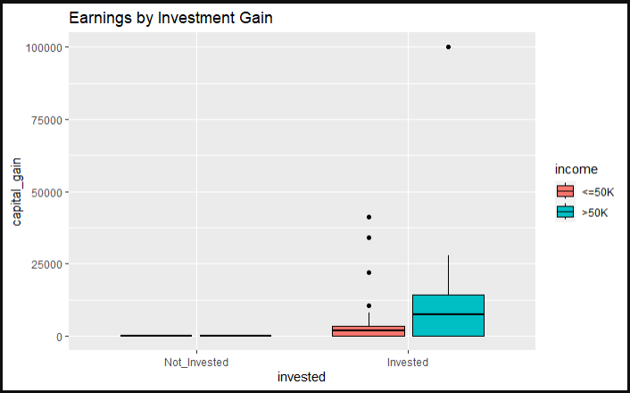
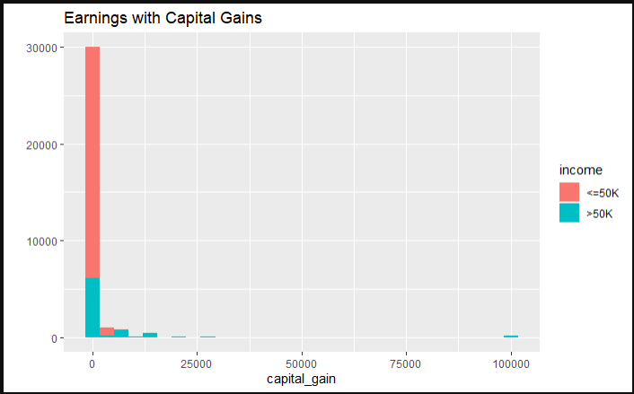
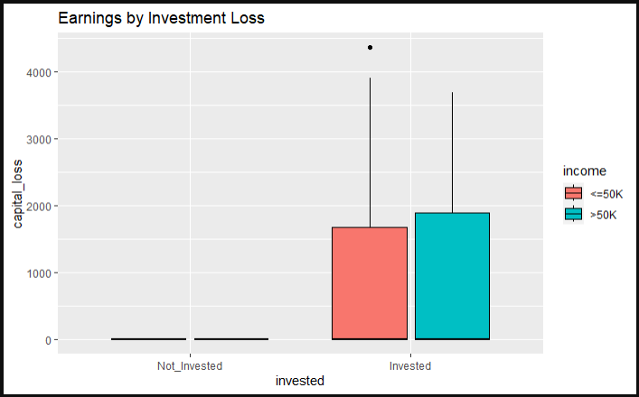
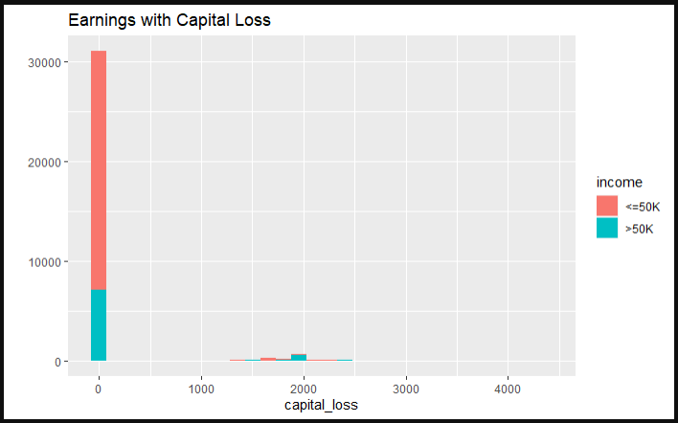
Visual Inspection
Investment -
Capital Gain - Very few values.
Capital Loss - Very few values
Both skewed toward >50K
Questionable Outliers
Notes:
It could help to use some graphics here to show how these graphs suggest skewed data. Just looking at the graph themselves it unclear what we want the reader to interpret

Slide 14
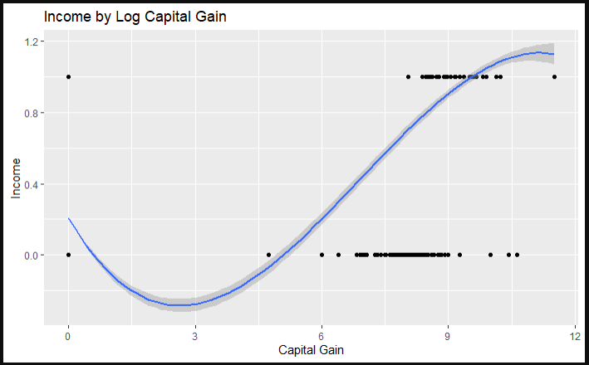
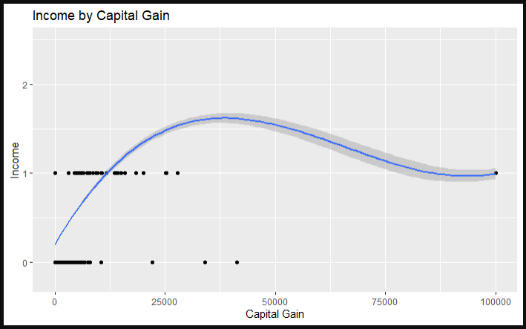
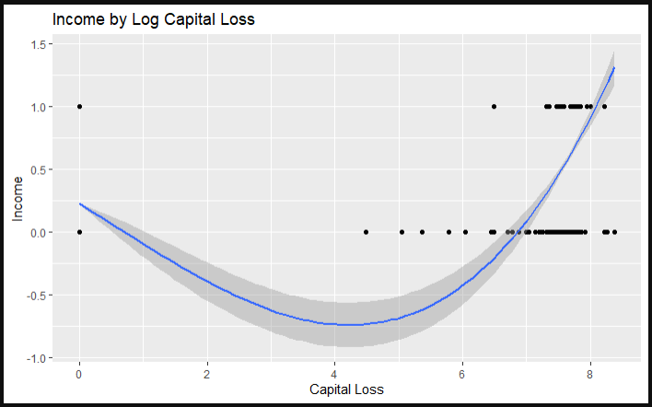
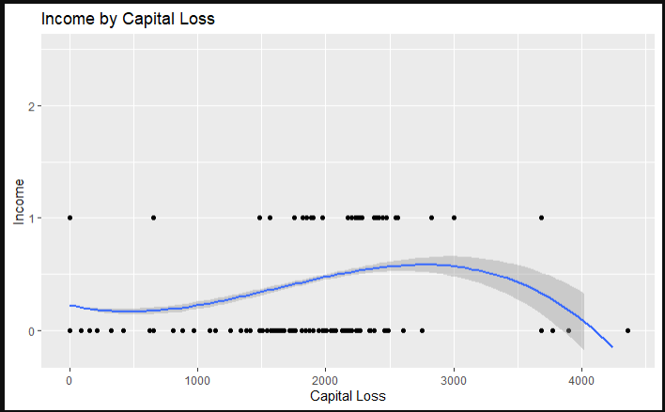
Loess Plot Comparison
Investment -
Outliers pull trend right
Logged Values balance outliers.

Slide 15
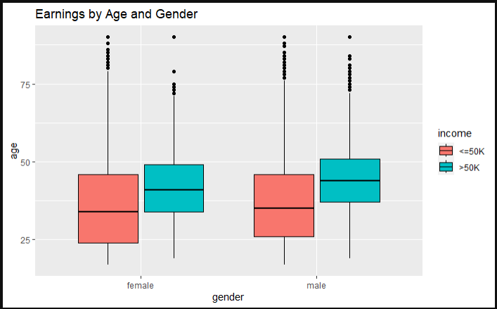
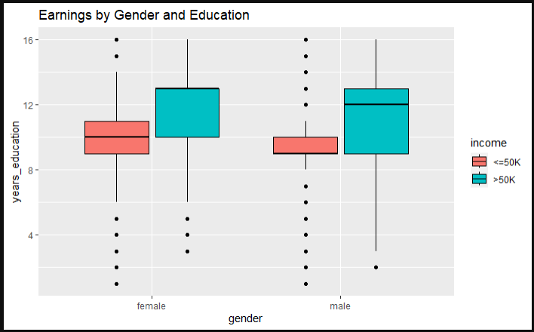
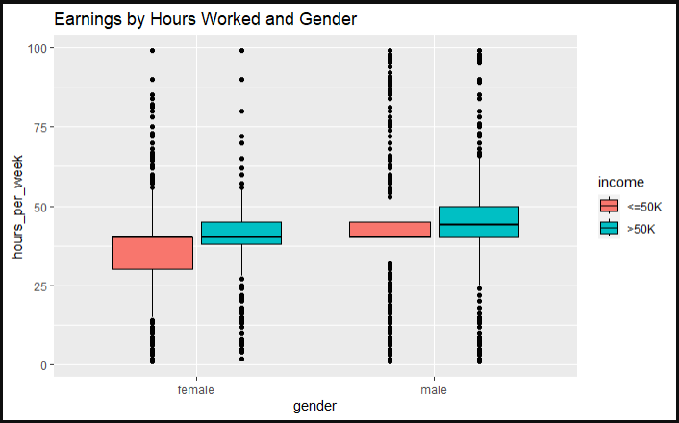
Visual Inspection
By Gender:
Age - Higher income group shows higher mean age. Is age related to income?
Hours - Some signs of difference in mean hours per week by income status among men and women
Education - High income group shows higher mean years of schooling.
Notes:
[Come back to this slide. LOESS curves do not show evidence of relationship between hours worked and odds of higher income status] Some evidence of overlapping distribution

Slide 16
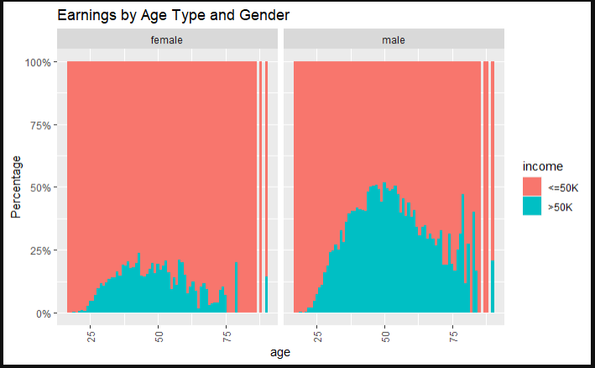
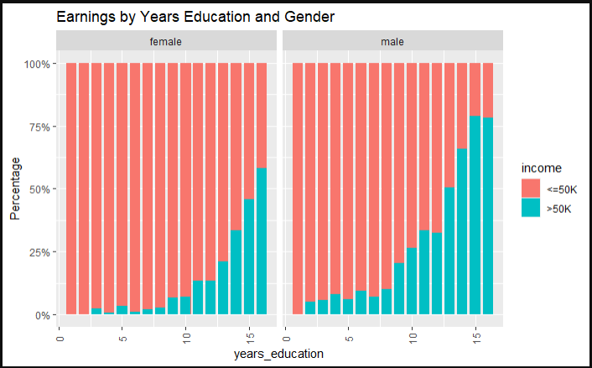
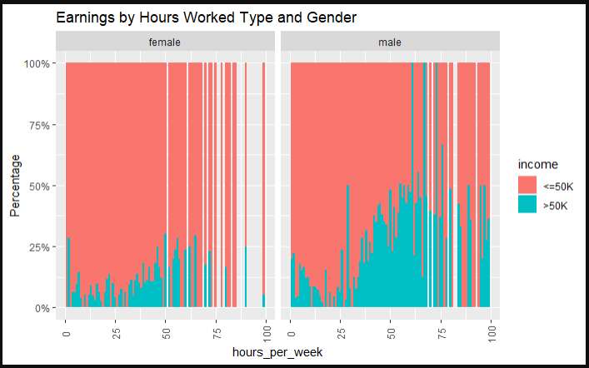
Visual Inspection
By Gender:
Age - Male and female percentages are normally distributed
Hours - Skewed left - with greater percentages favoring more hours
Education - High education means more income.
Notes:
[Come back to this slide. LOESS curves do not show evidence of relationship between hours worked and odds of higher income status] Some evidence of overlapping distribution

Slide 17
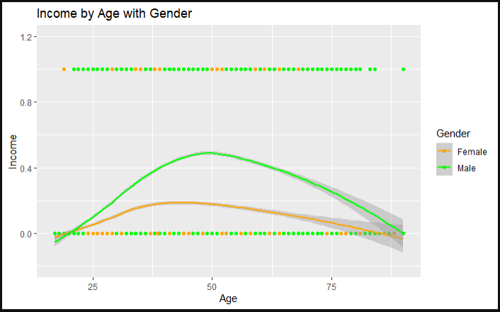
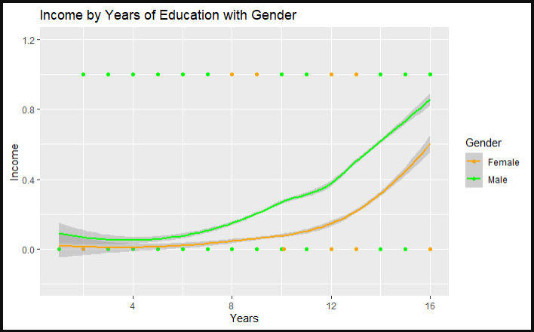
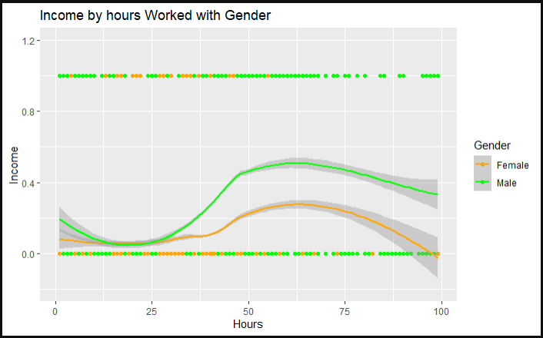
LOESS Plot Comparison
Age - Dropoff after 50 years with some complexity
Hours - Dropoff after 75 hours for males, females more flat
Education - Higher education, higher proportion of high-income statuses
Notes:
Gender (female, male)

Slide 18
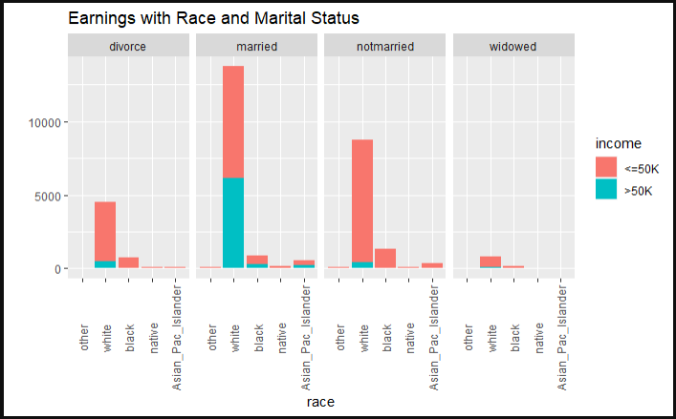
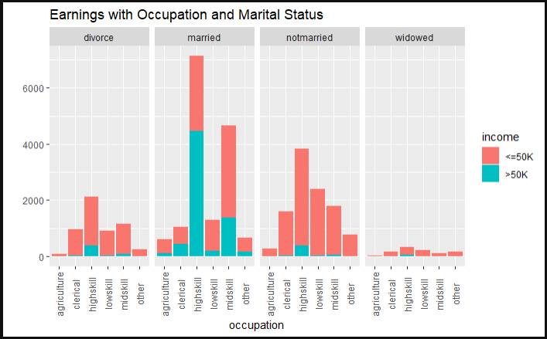
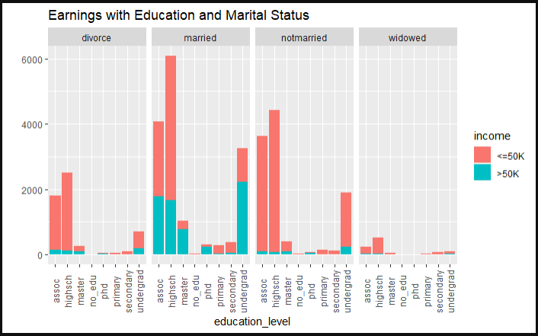
Visual Inspection
Marital Status
Race + Married potentially increases odds for income.
Possible interaction between marital status and education
Possible interaction between occupation and marital status
Notes:
Graphs are good, but we really should be referring to LOESS curves for evidence of relationships
“Race-Married” is also confusing. Are we saying there’s a multiiplicative relationship?

Slide 19
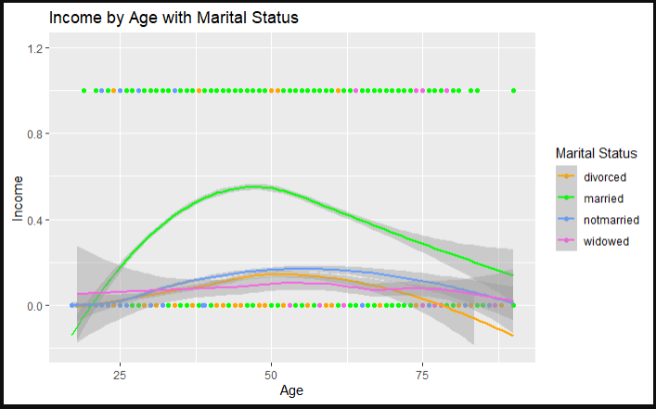
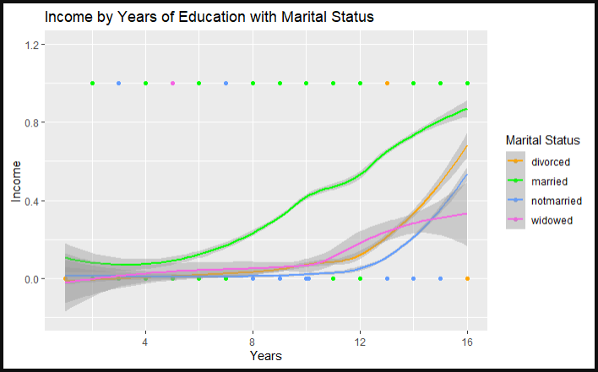
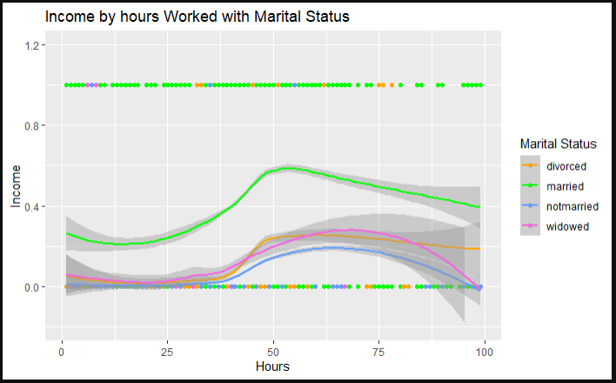
LOESS Plot Comparison
Age - Dropoff after 50 years with married, Others consistent
Hours - Dropoff after 50 hours with some complexity on divorced
Education - Higher education, higher proportion of high-income statuses, widowed variation from the line
Notes:
Race: (Other, White, Black, Native, Asian/Pacific Islander)

Slide 20
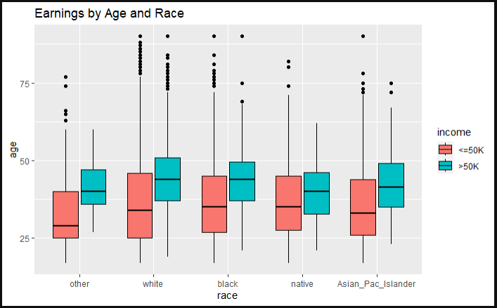
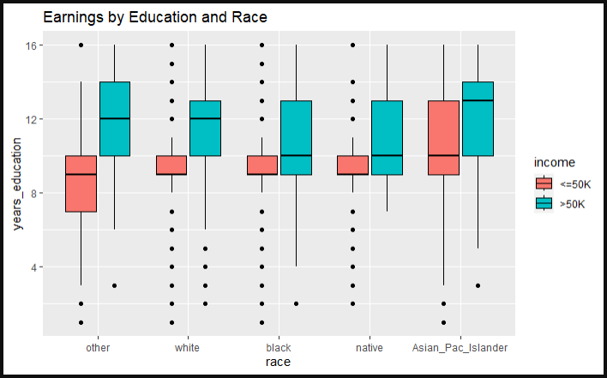
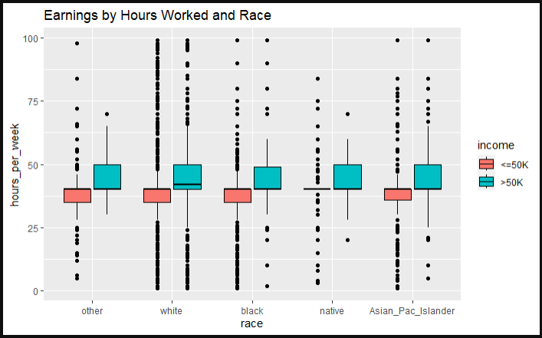
Visual Inspection
Race - consistent, but some overlap
Age - Mean age increases with income status
Hours - Mean hours worked seems to increase with income status
Education - More education seems to mean more money
Notes:
Add LOESS curve by age with color=race
Same for hours per week and years of education

Slide 21
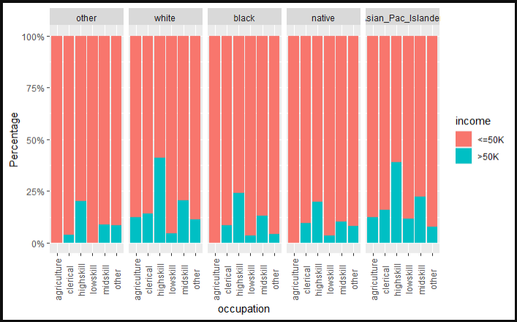
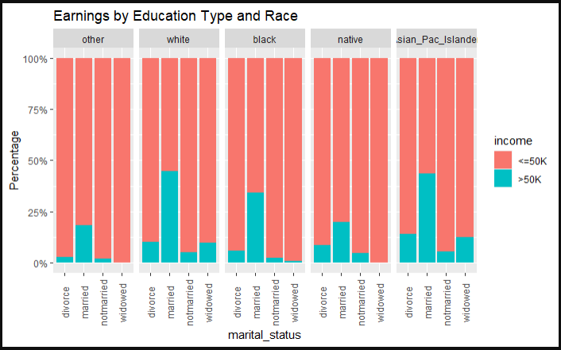
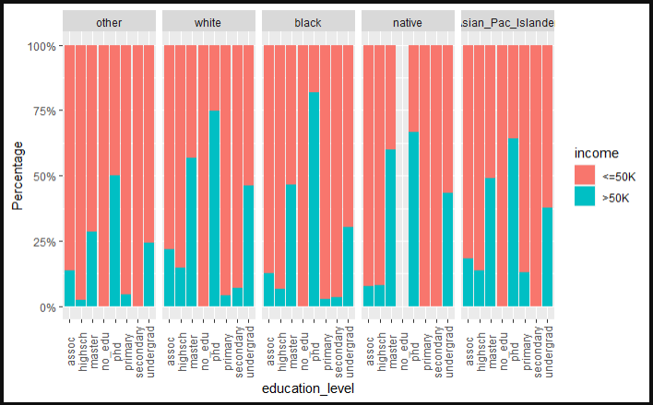
Visual Inspection
Race - Percentages
Occupation - Near equal percentages in each race.
Education Level - Equal percentages, favoring higher education
Marital status -balanced

Slide 22
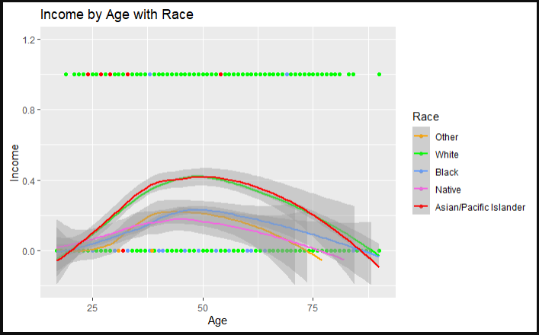
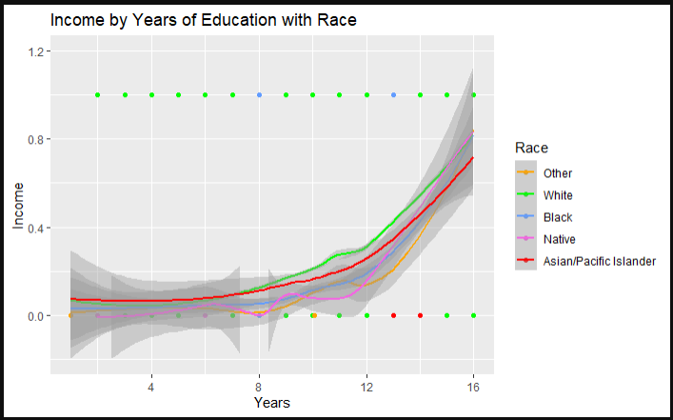
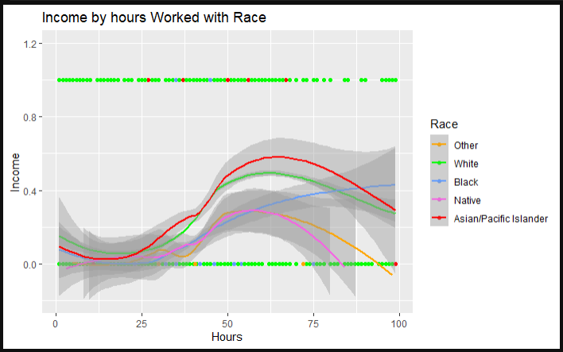
LOESS Plot Comparison
Age - Consistent reduction after 50 years
Hours - Except for Natives all race factors follow a similar trend
Education - Higher education, higher proportion of high-income statuses
Notes:
Race: (Other, White, Black, Native, Asian/Pacific Islander)
Race: 1- 5 (left to right)

Slide 23
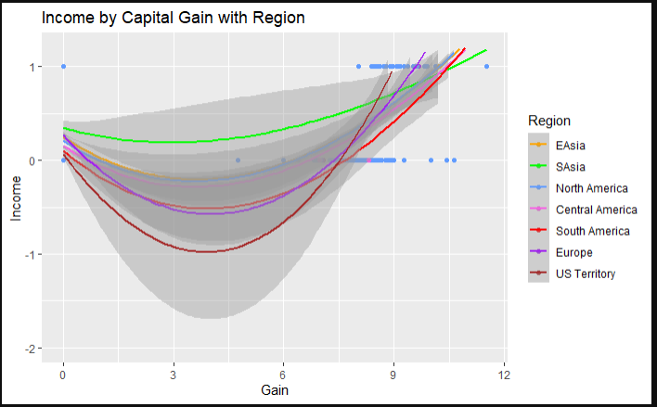
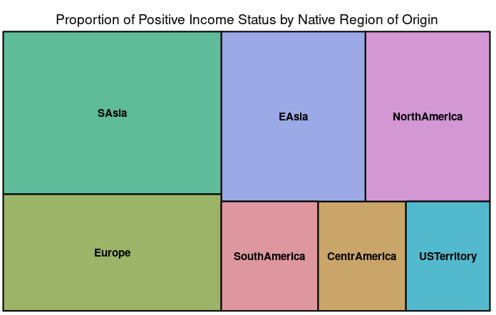
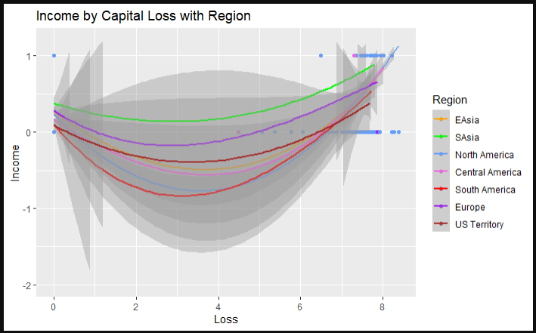
Native Region
Tree Maps:
Proportion of high income individuals varies by region of origin
Greater Size = Greater Relative Proportion of >50K
Notes:
Native Region: 1 - 7
1: EAsia
2: SAsia
3: North America
4: Central America
5: South America
6: Europe
7: US Territory

Slide 24
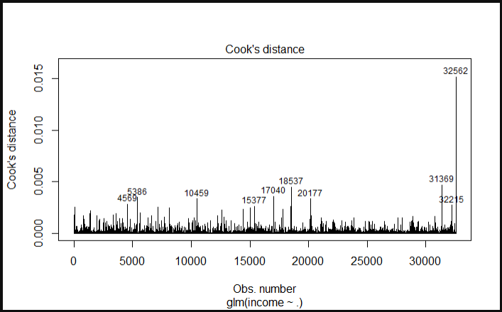
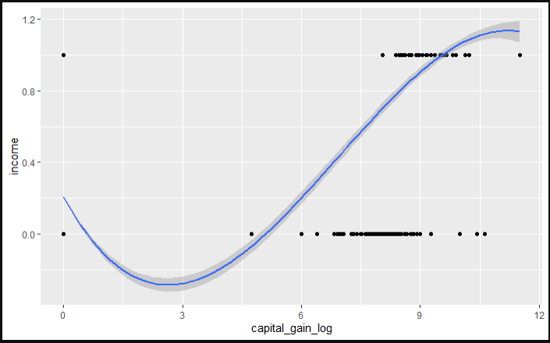
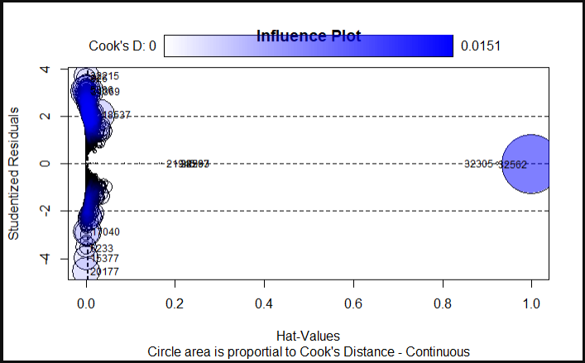
Check for Extreme Outliers with high influence
Transform
Log(Capital_gain)
Log(Capital_loss)
Check For Influential Outliers
Remove 14
Notes:
We might want to simplify this slide. The graphics are very complex are might be difficult to interpret without additio arrows or symbols showing where to look

Slide 25
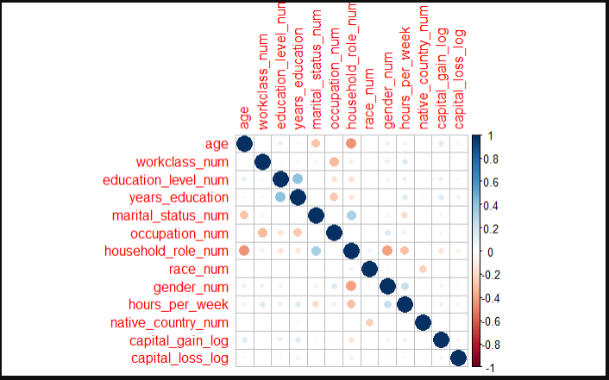
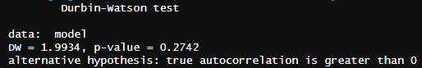
Check for Independence and Multicollinearity
Independence
Durbin-Watson close to 2 indicating no autocorrelation
VIFs look good with removed variables
Graph shows limited multicollinearity

Slide 26
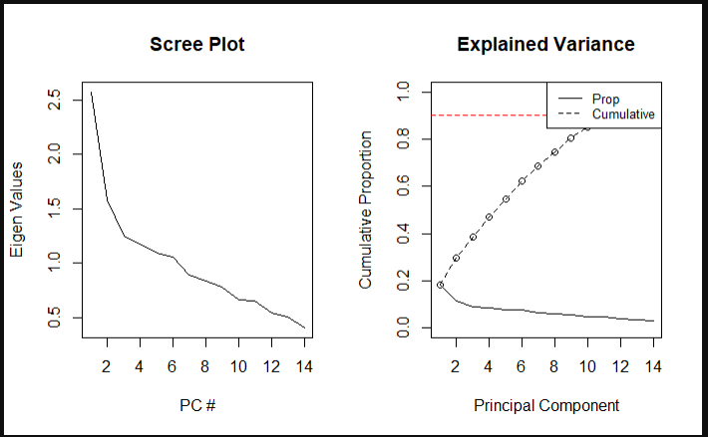

Model Reduction
PCA
Full - 12 Variables Recommended
PC1- high values for marital_status, education_level, age
PC2 - Capital_gain, Capital_loss
PC3 - Hours_Per_week
Reduced - 8 Variables Recommended
PC1 - Household_role, Invested, age
PC2 - Invested, Capital_loss, Years_education
PC3 - Occupation, Capital_loss, Invested
Notes:
Principal Component Analysis

Slide 27

Feature Selection
Models Used
GLMNET
Dropped only one variable
Stepwise: Forward/Backward/Both
No variables dropped
Stepwise with AIC
Three variables dropped
Reduced Formula:
income ~ age + years_education + capital_gain_log + capital_loss_log +
marital_status+ occupation + household_role + gender + race + hours_per_week
Notes:
Principal Component Analysis

Slide 28

Objective 1: Logistic Regression Model
Interpret and Predict Earnings

Slide 29
Generalized Logistic Regression Model (Full)
Income ~ Age + Workclass + Education_Level + Years_Education + Marital Status + Occupation + Household_Role + Race + Gender + Native_Region + log_Capital_Loss + log_Capital_Gain

Slide 30
Generalized Logistic Regression Model (Reduced)
Income ~ Age + Years_Education + Marital Status + Occupation + Household_Role + Gender + Hours_Per_Week + log_Capital_Loss + log_Capital_Gain

Slide 31


Full vs Reduced
Full
Reduced

Slide 32
Full vs Reduced
Minimal change in metrics with model reduction!

Slide 33


Reduced Model - Outlier Comparison
(AUROC)
Performance with Outliers
Performance without Outliers

Slide 34


Reduced Model - Outlier Comparison
(Metrics)
Performance with Outliers
Performance without Outliers
No change in performance with outliers removed!

Slide 35
Reduced Model - Outlier Comparison
(Metrics)
Performance with Outliers
Performance without Outliers
Coefficients interpreted with outliers

Slide 36
Logistic Model Interpretation

Slide 37

Odds Ratio
e
Interpreting Coefficients and Odds Ratios

Slide 38
Additive Change
Odds Ratio
e
Interpreting Coefficients and Odds Ratios
(e^{Coefficient} -1) *100%

Slide 39
Odds Ratio
e
Factor Change
Multiplicative Change in Odds
Interpreting Coefficients and Odds Ratios

Slide 40
Odds Ratio
e
Factor Change
Multiplicative Change in Odds
Interpreting Coefficients and Odds Ratios

Slide 41

Reduced Model Interpretation
(Numeric)
Years_Education:
There is evidence at the 95% confidence level that a 10-unit change in age corresponds to a 21.825787 (e^3.08309) factor increase in the odds of being high income.
CI: (18.25955, 26.08852).

Slide 42
Reduced Model Interpretation
(Numeric)
Log_Capital_Gain:
There is evidence at the 95% confidence level that a 10-unit change in log_capital_gain corresponds to an 2.161985 factor increase in the odds of being high income,
CI: (2.050229, 2.279832).

Slide 43
Reduced Model Interpretation
(Categorical)
occupationhighskill:
There is evidence at the 95% confidence level that the odds of a high-skill worker making >50K is 3.865477 times higher than those of an agricultural worker.
CI: (3.010316, 4.963568).

Slide 44
Reduced Model Interpretation
(Categorical)
gendermale:
There is evidence at the 95% confidence level that the odds of a male making >50K are 2.388176 times higher than those of a female.
CI: (2.043648 , 2.790788).

Slide 45
Model Interpretation
(Reduced)
Variable | Beta | p-Value | Odds Ratio | Confidence Interval
Intercept | Beta_0 | < 2e-16 | -7.498387 | (-8.020812970, -6.97596079)
Age | Beta_1 | < 2e-16 | 1.016655 | (1.013410, 1.019911)
Years_Education | Beta_2 | < 2e-16 | 1.36112 | (1.337054, 1.385623)
marital_statusmarried | Beta_3 | 0.00430 | 1.643003 | (1.168419, 2.310352)
marital_statusnotmarried | Beta_4 | 6.80e-12 | 0.5562727 | (.4704704, .6577234)
marital_statuswidowed | Beta_5 | 0.22970 | 0.822946 | (0.5988881, 1.130963)
95% Confidence Level
Reject null: Beta ≠ 0
Fail to Reject Null: Beta = 0

Slide 46
Model Interpretation
(Reduced)
Variable | Beta | p-Value | Odds Ratio | Confidence Interval
occupationclerical | Beta_6 | 1.61e-10 | 2.480215 | (1.877497, 3.276418)
occupationhighskill | Beta_7 | < 2e-16 | 3.865477 | (3.010316, 4.963568)
occupationlowskill | Beta_8 | 0.72441 | 0.9479021 | (0.7040284, 1.276253)
occupationmidskill | Beta_9 | 3.55e-11 | 2.358061 | (1.829278, 3.039697)
household_rolehusband | Beta_10 | < 2e-16 | 9.727894 | (6.433415, 14.70944)
Reject null: Beta ≠ 0
95% Confidence Level
Fail to Reject Null: Beta = 0

Slide 47
Model Interpretation
(Reduced)
Variable | Beta | p-Value | Odds Ratio | Confidence Interval
household_rolerelative | Beta_11 | 0.00605 | 2.009726 | (1.220959, 3.308055)
household_single_occ | Beta_12 | 6.94e-09 | 2.690550 | (1.924844, 3.760856)
household_roletenant | Beta_13 | < 2e-16 | 3.567003 | (2.679115, 4.749146)
household_rolewife | Beta_14 | < 2e-16 | 27.84856 | (17.92502, 43.22814)
gendermale | Beta_15 | < 2e-16 | 2.388176 | (2.043648, 2.790788)
raceblack | Beta_16 | 0.53106 | 1.084393 | (0.8415676, 1.397283)
Reject null: Beta ≠ 0
95% Confidence Level
Fail to Reject Null: Beta = 0

Slide 48
Model Interpretation
(Reduced)
Variable | Beta | p-Value | Odds Ratio | Confidence Interval
racenative | Beta_17 | 0.38926 | 0.8033304 | (0.488035, 1.322669)
racewhite | Beta_18 | 0.04187 | 1.244259 | (1.008067,1.535791)
log_capital_loss | Beta_19 | < 2e-16 | 1.053274 | (1.045891, 1.060709)
log_capital_gain | Beta_20 | < 2e-16 | 1.080153 | (1.074435, 1.085901)
Reject null: Beta ≠ 0
95% Confidence Level
Fail to Reject Null: Beta = 0

Slide 49
Objective 2: Predictive Models

Slide 50




Complex Model with Native Region as an interaction
Model performed okay and close to the more simplistic models.
However the Residuals vs Fitted plot shows evidence that a polynomial fit might be beneficial.
Notes:
Steven lead

Slide 51




Complex Model with Native Region as an interaction and polynomial capital gains and loss
The model performs slightly better and the Residual vs Fitted plot no longer shows a pattern. However, there appears to be little gain in performance at the cost of interpretability.
Notes:
Steven lead - double check the threshold graph. Prevalence is changing when it shouldn’t

Slide 52






Additional Complex Model Metrics
Numerous models and interactions were ran, with little to no additional benefit in performance or interpretability. Here are a few of the metrics. For additional information, please refer to the RMD file.

Slide 53

Linear Discriminant Analysis
Notes:
Joel

Slide 54

Linear Discriminant Analysis
(LDA)
Equal variance between scaled, logged variables
LDA is Viable

Slide 55

Linear Discriminant Analysis
(LDA)
Only 3 variables show any semblance of normal distribution:
Log_age
Log_years_education
log_ hours_per_week

Slide 56



LDA
No Capital
Sub-par performance, compared to past models
Lack of normally distributed continuous variables likely drags down performance
Notes:
Add scatterplot of yes and no values, maybe show QDA for comparison

Slide 57



LDA
With Capital
Slightly improved, still unsatisfactory
Notes:
Add scatterplot of yes and no values, maybe show QDA for comparison

Slide 58


LDA
With Capital
QDA
Without Capital
Notes:
Add scatterplot of yes and no values, maybe show QDA for comparison

Slide 59


LDA
With Capital
QDA
With Capital
With or without Capital, LDA and QDA are sub-par
Notes:
Add scatterplot of yes and no values, maybe show QDA for comparison

Slide 60


Non-Parametric Models
Notes:
Adam lead:

Slide 61



Support Vector Machine
Performance:
Threshold 10 percent.
Solid identification of True positives (<=50k) and negatives (>50k)
ROC shows good discrimination
Difficult to adjust
Notes:
This model was difficult to adjust in a logical way. (Under and over fitting)

Slide 62



Classification and Regression Trees (CART)
Performance:
Threshold 22 percent.
Solid identification of True positives (<=50k) and negatives (>50k)
ROC shows good discrimination
Higher Complexity
Notes:
The complexity of a model impact performance most. Smaller numbers are better. **The reduced model performed best overall.

Slide 63




Random Forest
Performance:
Threshold 28 percent.
Solid identification of True positives (<=50k) and negatives (>50k)
ROC shows good discrimination
Notes:
Performed better with full model and outliers removed. Uses non-parametric methods.

Slide 64




FeedForward Neural Network
Performance:
Threshold 28 percent.
Solid identification of True positives (<=50k) and negatives (>50k)
ROC shows good discrimination
Notes:
Performed better with full model and outliers removed. Uses parametric methods but is very difficult to interpret.

Slide 65


Comparative Performance
Notes:
Performed better with full model and outliers removed. Uses parametric methods but is very difficult to interpret.

Slide 66
Summary
Model | AUROC | Accuracy | Sensitivity | Specificity | PPV | NPV
Neural Network | 91.11% | 82.99% | 82.47% | 83.16% | 60.87% | 93.73%
Random Forest | 89.98% | 82.78% | 81.21% | 83.70% | 60.88% | 92.90%
CART | 90.45% | 82.22% | 81.39% | 82.49% | 59.62% | 90.45%
Support Vector Machine | 89.17% | 83.25% | 78.01% | 84.92% | 62.16% | 92.40%
Complex GLM | 89.32% | 80.79% | 81.08% | 80.81% | 57.59% | 92.95%
Simple GLM | 89.32% | 80.61% | 80.23% | 79.94% | 54.31% | 93.15%
LDA | 83.00% | 74.71% | 74.26% | 76.21% | 91.31% | 46.81%

Slide 67
Summary
Model | AUROC | Accuracy | Sensitivity | Specificity | PPV | NPV
Neural Network | 91.11% | 82.99% | 82.47% | 83.16% | 60.87% | 93.73%
Random Forest | 89.98% | 82.78% | 81.21% | 83.70% | 60.88% | 92.90%
CART | 90.45% | 82.22% | 81.39% | 82.49% | 59.62% | 90.45%
Support Vector Machine | 89.17% | 83.25% | 78.01% | 84.92% | 62.16% | 92.40%
Complex GLM | 89.32% | 80.79% | 81.08% | 80.81% | 57.59% | 92.95%
Simple GLM | 89.32% | 80.61% | 80.23% | 79.94% | 54.31% | 93.15%
LDA | 83.00% | 74.71% | 74.26% | 76.21% | 91.31% | 46.81%

Slide 68
Summary
Model | AUROC | Accuracy | Sensitivity | Specificity | PPV | NPV
Neural Network | 91.11% | 82.99% | 82.47% | 83.16% | 60.87% | 93.73%
Random Forest | 89.98% | 82.78% | 81.21% | 83.70% | 60.88% | 92.90%
CART | 90.45% | 82.22% | 81.39% | 82.49% | 59.62% | 90.45%
Support Vector Machine | 89.17% | 83.25% | 78.01% | 84.92% | 62.16% | 92.40%
Complex GLM | 89.32% | 80.79% | 81.08% | 80.81% | 57.59% | 92.95%
Simple GLM | 89.32% | 80.61% | 80.23% | 79.94% | 54.31% | 93.15%
LDA | 83.00% | 74.71% | 74.26% | 76.21% | 91.31% | 46.81%

Slide 69
Future Projects
Additional Sampling
Sample additional individuals
Additional Demographic Information
Collect data on new variables
Model Refinement
Test new models
Population Predictions And New Test Set
Make predictions on total population by income group Test model performance on more recent datasets
Pro:
Larger dataset, new insights
Con:
Logistical and time constraints
Pro:
Increased versatility
Con:
Financial and time constraints
Pro:
Potentially increased reliability and precision
Con:
Bias Variance Trade-off

